Slide 1
Lecture
Open innovation

Slide 2
Free and Open Source Software
Title: Presentation
Subtitle field
Context: Apple “look and feel” (vs. Franklin Computer Corp., 1983)
Stallman’s GNU and the Free Software Foundation, 1985
Major innovation: GPL, General Public Licence, 1986
= Copyleft
Problems
Centralized development: the Cathedral
Difficult to incorporate third-party programs
Ignored the development of the PC market
Non robust Kernel
BSD (Berkeley Software Distribution) also failed
Licensing was too permissive (not forcing the code to be shared)
Legal battle between Unix distribution and BDSI

Slide 3
linux
Title: Presentation
Subtitle field
“software is like sex: it’s better when it’s free.” – Linus Torvalds
Finland
Internet distribution
PC native
Main motivation: Money or more precisely, the lack of
Free software <> All other GNU projects
Linux trademark battle with Della Croce in US, similar lawsuits in the world
By 2007, Linux International spent USD 300000 protecting Linux trademark
Linux success
GPL Licensing respects hacker mores
Free kernel
Strong decentralized community = The Bazaar approach
“Given enough eyeballs, all bugs are shallow.”

Slide 4
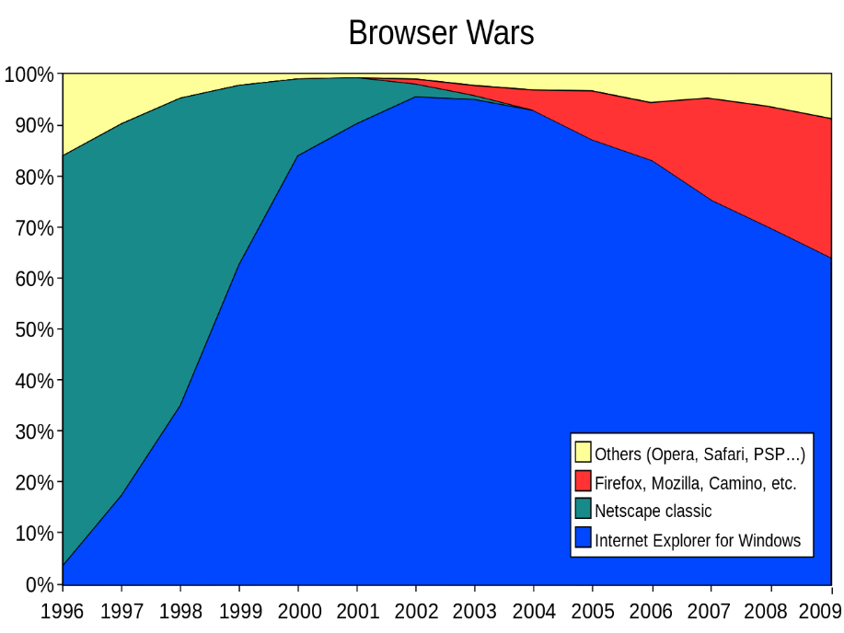
Netscape and the war against Microsoft
Title: Presentation
Subtitle field
Mozilla Public License in between BSD and GPL, 1998
War with Microsoft: “embrace, extend, extinguish.”
Lawsuit filed by SCO group backed by Microsoft: Linux copied code derived from Unix, ended in 2007

Slide 5
android
Title: Presentation
Subtitle field
Acquisition of Android Inc. by Google in 2005 (software for cameras)
2007: first operating system based on the Linux kernel
Uses alternative FOSS licenses that allows Google to keep code secret and incorporate non free applications and components.
Google vs. Oracle, 2010-2021
Supreme Court
11500 lines of code from Java: fair use

Slide 6
Free culture and open innovation
Title: Presentation
Subtitle field
Encourages re-use, remix
User generated content (UGC)
Mods (video-games)
Collaborative innovations (Wikipedia)

Slide 7
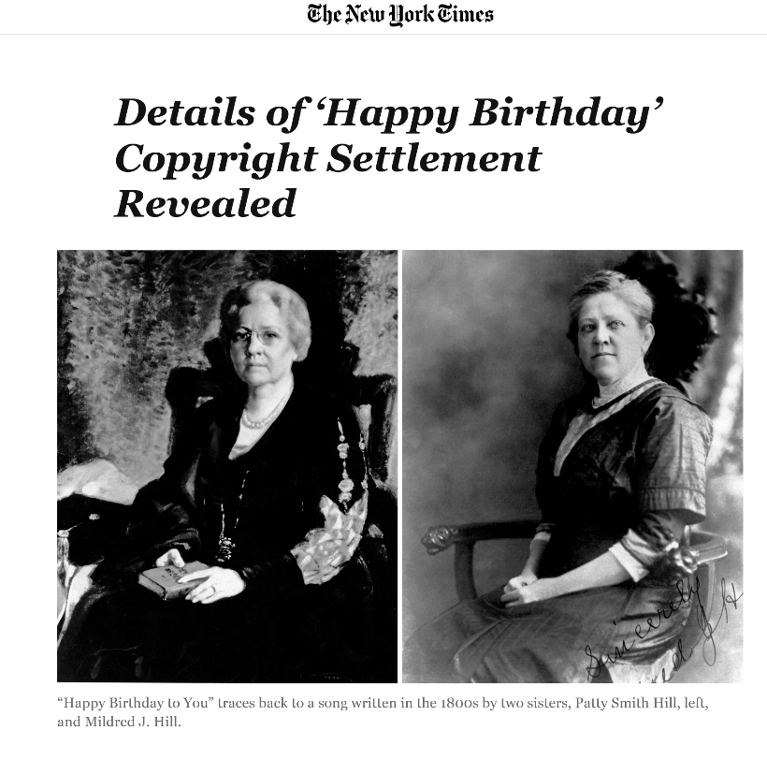
remix
Title: Presentation
Subtitle field
2016: USD 14 million settlement by Warner Music group
Since 1988, USD 2 million/year in royalties

Slide 8
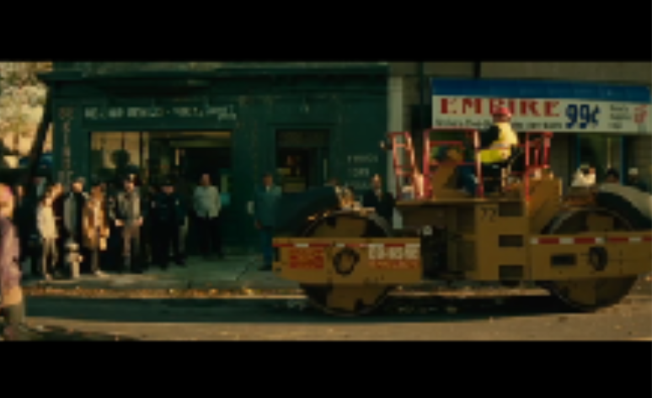
REMIX
Title: Presentation
Subtitle field

Slide 9

MODS
Title: Presentation
Subtitle field

Slide 10
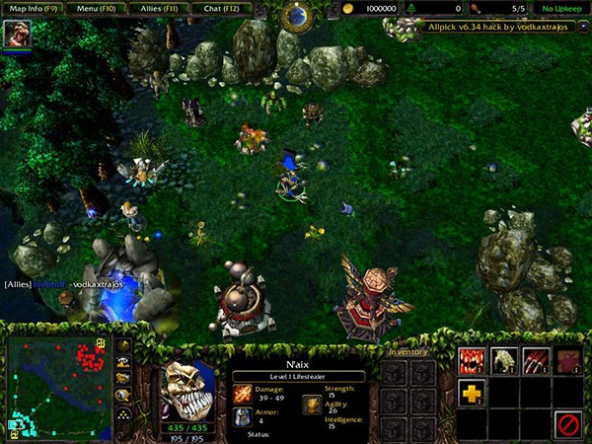
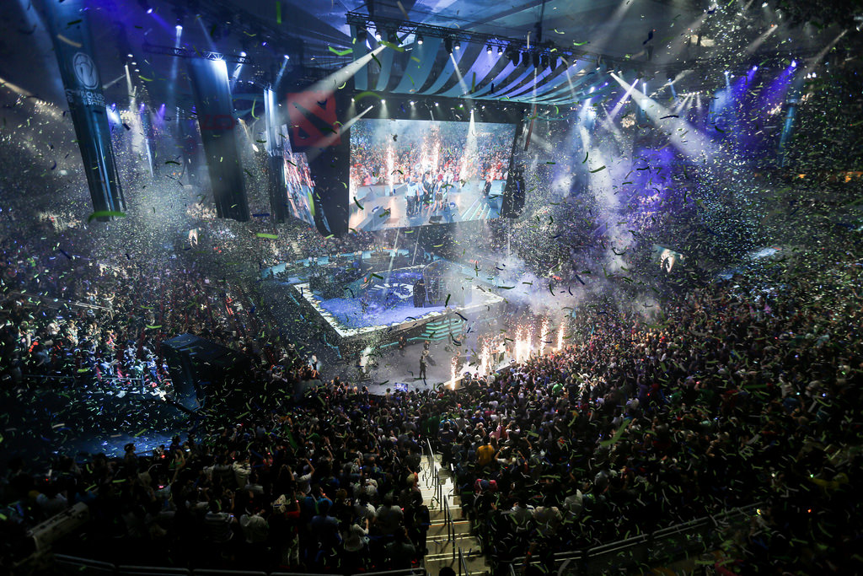
MODS
Title: Presentation
Subtitle field

Slide 11

Makers
Title: Presentation
Subtitle field

Slide 12

Free innovation
Title: Presentation
Subtitle field
Main theory of von Hippel:
User-generated innovations

Slide 13
Title
Subtitle

